Slide 1
WELCOME TO
tendersinfo.export.gov.il
Tenders service search tutorial & Tendering Advisory

Slide 2
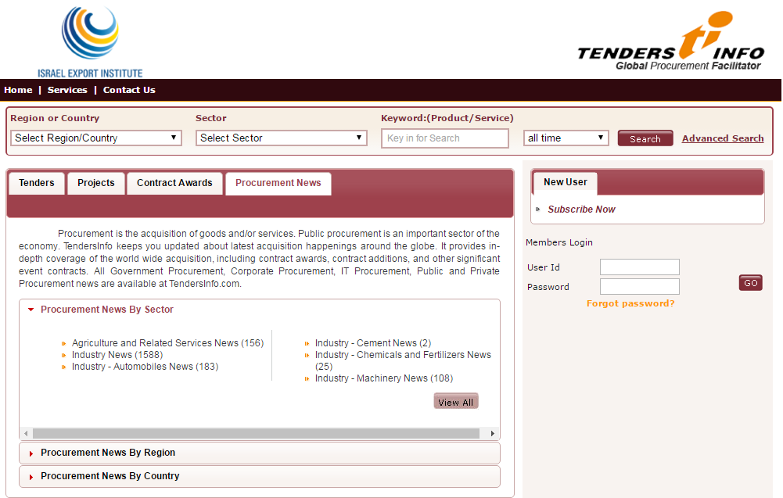
Home Page
For new User's to
create an account.
User login

Slide 3
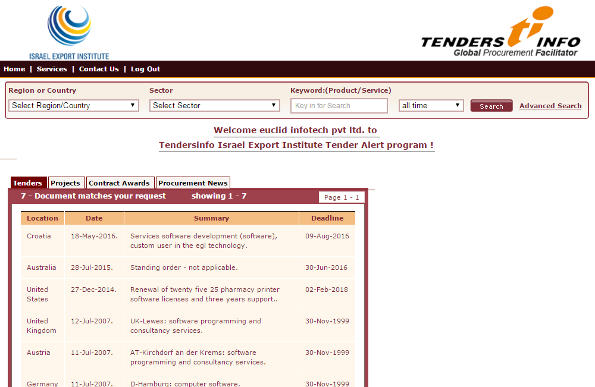
AFTER USER HAS LOGGED IN
Once you have sucessfully
logged in, live tender as per
your
Product profile will
be displayed on the
screen

Slide 4
SEARCH & ADVANCE SEARCH
You can search for business leads as per your requirement with the help of “ Search” using "Region or Country" , "Sector", "Keyword" or "Date" or else can choose the “AdvancedSearch” option.

Slide 5
Choose country
Or region from
the list
Choose sector
From the lsit
Add your
keywords
Select the
date
Advance
Search to
Fine-Filter

Slide 6
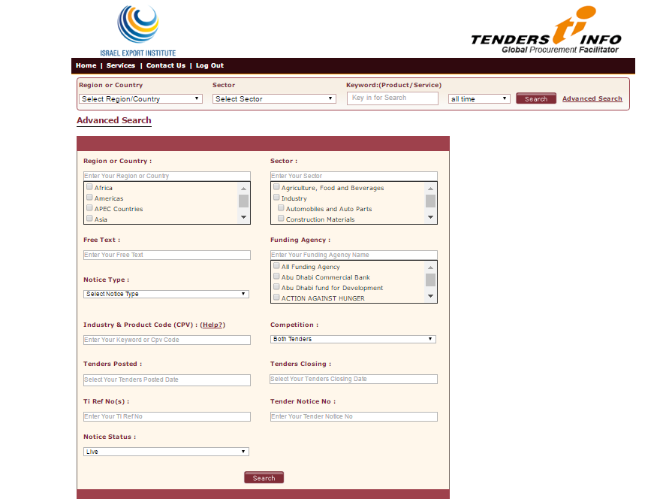
ADVANCE SEARCH
Advance Search option has more search options to filter business opportunities matching to your criteria. You don't have to fill all the fields. Just put values in those fields which are in your Search Criteria
Select region or
country
from the list
Select sector from
the lsit
Filter information
Using free text
Select the desired
funding agency from the list
Select Notice
type
Select the type of tender
Enter your
keywords
Select the desired
closing date
Select desired
publishing date
Enter Ti
reference no
Enter the tender
notice no.
Select notice
type

Slide 7
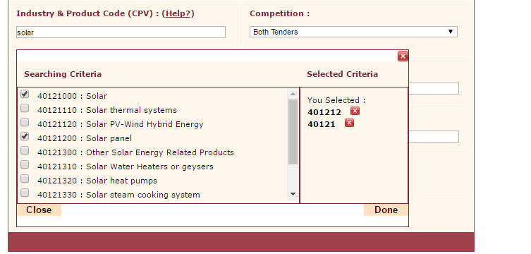
Industry & Product Code (CPV)
By typing in the keyword a drop down lsit of Common Procurement Vocabulary (CPV) will appear related to your keyword which will help you fetch the exact information.
After selecting the necessary CPVs of your choice from the list it will appear on the right hand side in the box. Click on “Done” to add CPV to filter information.
Your selected
CPV codes.
Unique
CPV codes

Slide 8
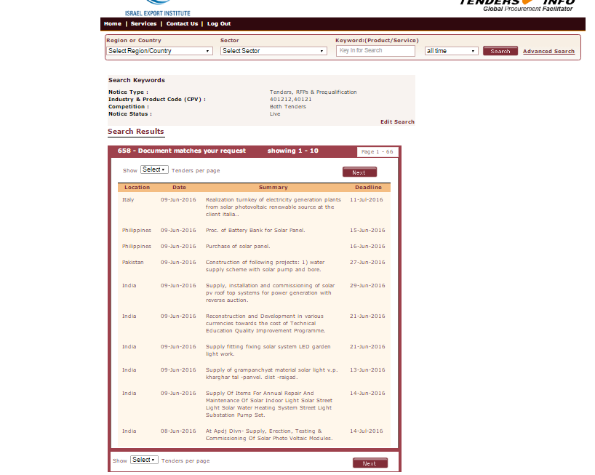
SEARCH RESULTS
After selecting the CPVs and clicking done , then click on search the following Search Result page will appear.
You can edit you search
By clicking on Edit Search
List of Documents
matching your request.
Click on the
summary
To view Tender details

Slide 9
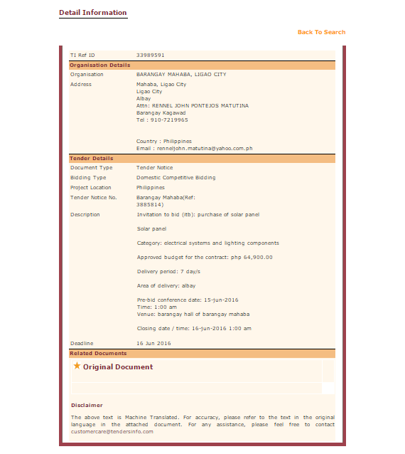
After clicking on the Tender's summary, the Tender detail information page will open
You can go back
to your
Search result page

Slide 10
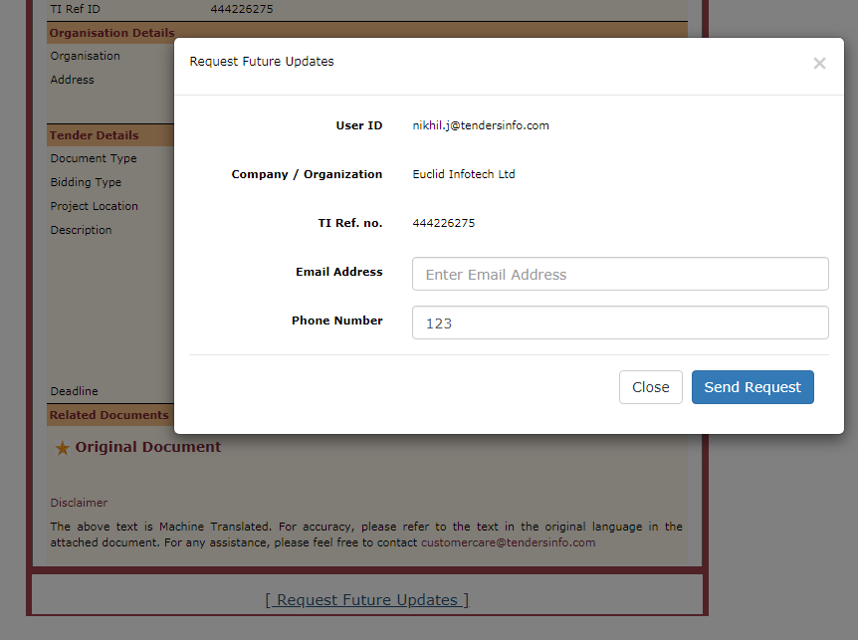
Request for more information via “Request Future Updates” button on each opportunity
You can click to seek more information

Slide 11
dfgd
For any queries please contact us at: kunal.talreja@tendersinfo.com nikhil.j@tendersinfo.com naorm@export.gov.il

